Slide 1
01
EXPLORE PHASE

Slide 2
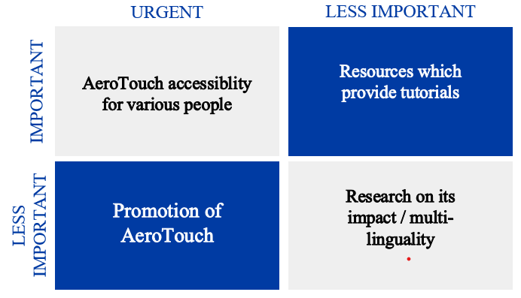
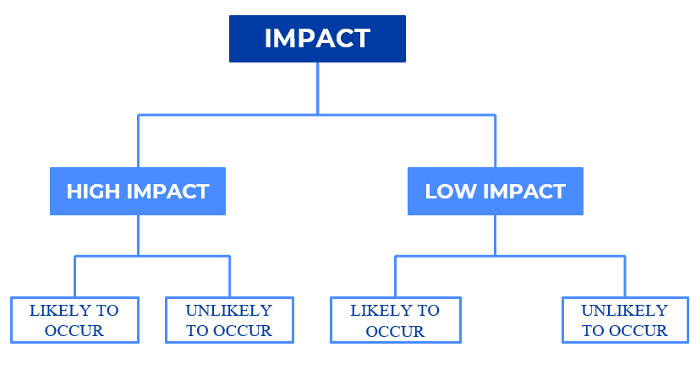
STEEP ANALYSIS
1
ECONOMY
4
TECHNOLOGY
2
ENVIRONMENT & NATURE
5
SOCIAL AND DEMOGRAPHIC
3
POLITICS & LEGAL

Slide 3
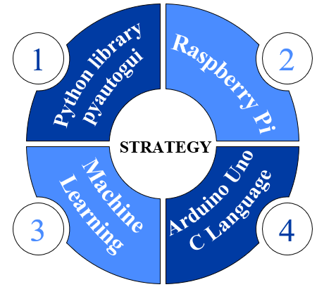
MAPPING ORGANIZATION ACTIVITY
Q
What opportunities and/or challenges need immediate attention going forward for your design challenge?
Q
What would it take to create positive change on this issue relating to your design challenge?
Q
What would it take to create positive change on this issue relating to your design challenge?
Q
Who else would be interested in this issue? Why should they care?

Slide 4
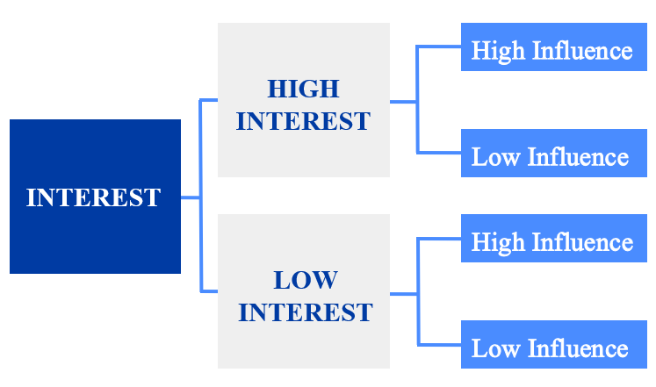
STACKHOLDERS
Links & Relationship Mapping
Priority Mapping
Investors
Shipping Company
Tech Companies
Sponsorship
Social Media Influencers
Project Team

Slide 5
PROJECT BREIF
CHALLENGES
OPPURTINITIES
Design Challenge
Adaptability
Python library
pyautogui
Raspberry Pi
Goal Fulfilment
Team Work
Stakeholder Challenges
Skill Development
Machine
Learning
Arduino Uno
C Language
Previous Efforts
Learning from Failures
Target users Challenge
Domain Knowledge

Slide 6
03
EXPERIMENT PHASE

Slide 7
SCAMPER WORKSHEET
S
SUBSTITUTE
Ardunio Uno
Python AutoGUI
C
COMBINE
Haptic Feedback
Machine Learning
A
ADAPT
Keyboard & Language
Environmental Changes
M
MODIFY
Typing Speed
Hand Orientation
P
PUT TO USE
M
Multi-Purpose
Gaming Interactions
E
ELIMINATE
Recognized Gestures
External Computer
R
REVERSE
Visualizing/ Customizing data
Short Hand Input

Slide 8
RECONNECTING WITH OUR PERSONAS
Behaviour
Pain Points
Aspirations
User Insights
Motivation
Deep User Needs
Challenges
Constrains & Design

Slide 9
04
ENGAGE PHASE

Slide 10
STAKEHOLDERS
1
2
Python library
pyautogui
Raspberry Pi
STRATEGY
Machine
Learning
Arduino Uno
C Language
3
4

Slide 11
05
EVOLVE PHASE

Slide 12
IMPACT EVALUATION INDICATORS
Social Value
Creation
Our social value of creating this product is mainly for the specially abled people.
Specially abled people and their family members; Non-profit cooperation groups
Stakeholder Satisfaction
Observe the Satisfaction of specially-abled individuals and their families by the impact created by Aerotouch on their daily lives.
Care givers and Health professionals are the secondary stakeholders of this project.
Solution Sustainability
Financially and Training sustainability for long-term usage by assessing programs for users, caregivers, and professionals.
Assistive expertise for long term maintanance; Manufacturers and suppliers.
Solution Scalability
Track the growth and measure the adoptability of the users towards the project.
Investors and Sponsors; Accessibility Experts to ensure whether the project continues to meet evolving accessibility.

Slide 13
IDENTIFYING QUICK WIN
What are the resources/ staffs needed?
What is this Quick Win about?
What are the success indicator(s)?
?
Achieving Quick Win can be a great way in promoting our product to wide range of people.
Growth in usage rate by specially abled people and their consistent usage over time.
A team for financial planning and a team with experts in all the fields related to this project.
Who will lead this Quick Win implementation?
What is the timeline till completion?
When will be the status or progress update?
A reliable project manager will be responsible for organize, coordinate, manage and supervise.
Quick Win Identification – 5 days; Detailed planning and resource allocation -7 weeks;
During team meetings and monthly progress updates and also after getting feedbacks from the users to consolidate and rectify it.

Slide 14
THINK- Ability
Gaining a deeper understanding of the needs and experiences of users to engage in empathy mapping exercises.
DO- Systems
Encourage team members to have a common goal and to communicate with each other.
FEEL-Role
Put yourself in the shoes of the users, considering their emotions, thoughts, and pain points.
MARS framework
THINK- Ability
As you listen intently to others, get clarification when needed, and answer with compassion.
FEEL-Role
Provide a secure, accepting atmosphere where team members can freely express their opinions.
DO- Systems
Openly and constructively resolve disputes and conflicts. Assist team members in establishing and finding solutions.

Slide 15
Our Target
COST EFFICIENCY
SPECIALLY ABLED PEOPLE
80%
Low Cost
WORKING PEOPLE
Accessibility & Customization
20%
BENEFITS

